Slide 1
What is SDR?

Slide 2
Software Defined Radio
SDR is radio communications that are traditionally implemented in hardware such as mixers, filters, etc., but instead are now accomplished using software.
Beginnings in he 70s and 80s with DARPA and what is now Raytheon.
Really took off in the 90s with the USAF developing a system called SpeakEasy that had a goal of communicating from 2MHz to 2GHz covering 10 different radio protocols, encrypted and un-encrypted

Slide 3
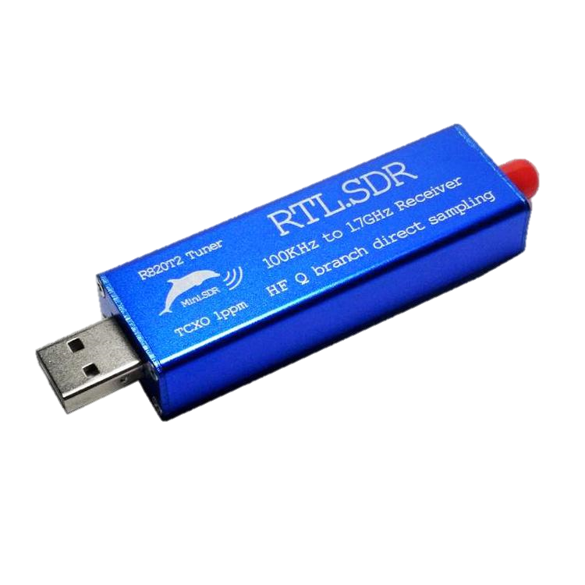
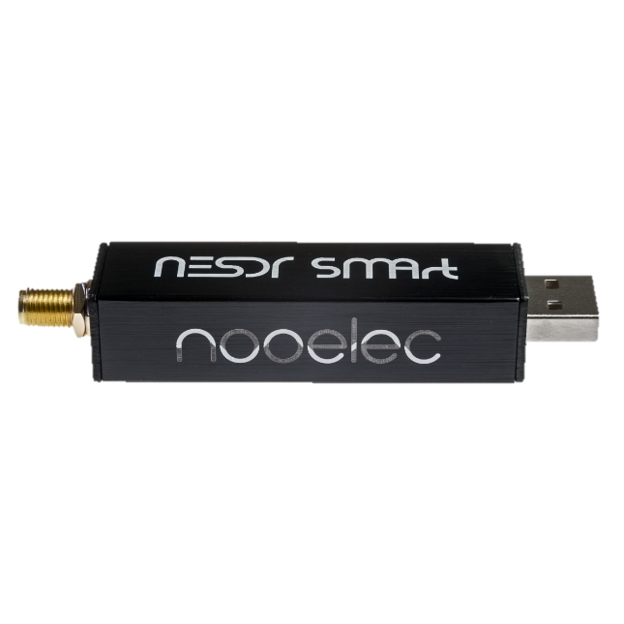
What about all of the USB dongles?
The origins of RTL-SDR stem from mass produced DVB-T TV tuner dongles that were based on the RTL2832U chipset. With the combined efforts of Antti Palosaari, Eric Fry and Osmocom (in particular Steve Markgraf) it was found that the raw I/Q data on the RTL2832U chipset could be accessed directly, which allowed the DVB-T TV tuner to be converted into a wideband software defined radio via a custom software driver developed by Steve Markgraf.
https://www.rtl-sdr.com/about-rtl-sdr/

Slide 4
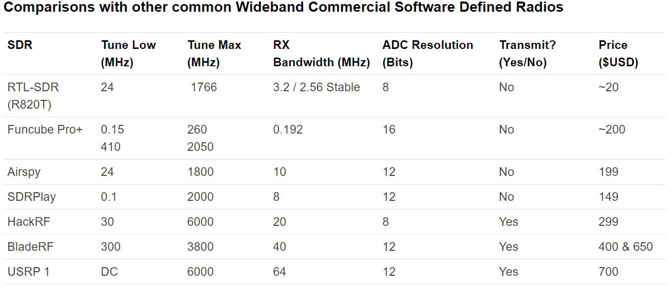
Popular Options

Slide 5
What can I do with my $20 SDR stick?
Use as a police radio scanner.
Listening to EMS/Ambulance/Fire communications.
Listening to aircraft traffic control conversations.
Tracking aircraft positions like a radar with ADSB decoding.
Decoding aircraft ACARS short messages.
Scanning trunking radio conversations.
Decoding unencrypted digital voice transmissions such as P25/DMR/D-STAR.
Tracking maritime boat positions like a radar with AIS decoding.
Decoding POCSAG/FLEX pager traffic.
Scanning for cordless phones and baby monitors.
Tracking and receiving meteorological agency launched weather balloon data.
Tracking your own self launched high altitude balloon for payload recovery.
Receiving wireless temperature sensors and wireless power meter sensors.
Listening to VHF amateur radio.
Decoding ham radio APRS packets.
Watching analogue broadcast TV.
Sniffing GSM signals.
Using rtl-sdr on your Android device as a portable radio scanner.
Receiving GPS signals and decoding them.
Using rtl-sdr as a spectrum analyzer.
Receiving NOAA weather satellite images.
Listening to satellites and the ISS.
Radio astronomy.
Monitoring meteor scatter.
Listening to FM radio, and decoding RDS information.
Listening to DAB broadcast radio.
Listening to and decoding HD-Radio (NRSC5).
Use rtl-sdr as a panadapter for your traditional hardware radio.
Decoding taxi mobile data terminal signals.
Use rtl-sdr as a high quality entropy source for random number generation.
Use rtl-sdr as a noise figure indicator.
Reverse engineering unknown protocols.
Triangulating the source of a signal.
Searching for RF noise sources.
Characterizing RF filters and measuring antenna SWR.
Decoding Inmarsat STD-C EGC geosynchronous satellites.
Listening to the ISS (International Space Station).
Not all of these are legal in every country
WOW

Slide 6
Police Scanner with Unitrunker
Unitrunker features
Allows one SDR Dongle to monitor a trunked or simulcast system
Supports routing audio through Virtual Cable
Important because it allows decoding of audio with DSDPlus
Supports Re-banded systems
Can link with Radio Reference website if you have a paid account with them
http://www.unitrunker.com/ Author Rickey Parrish KD4VXY (Expired in 2015)

Slide 7
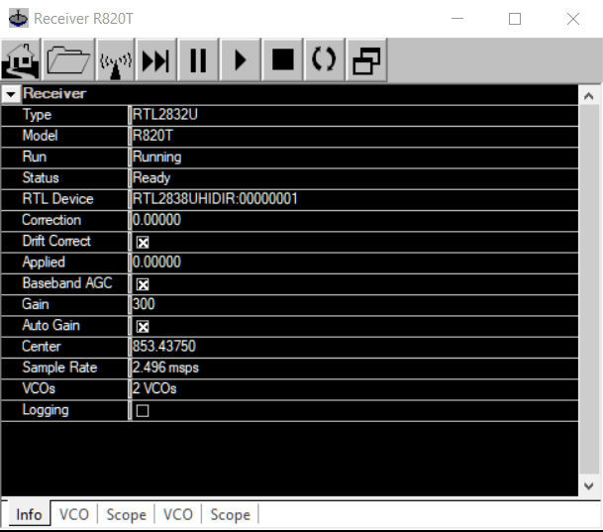
Unitrunker Settings
Choose your device
Set to 2 VCOs
(default is 3)

Slide 8
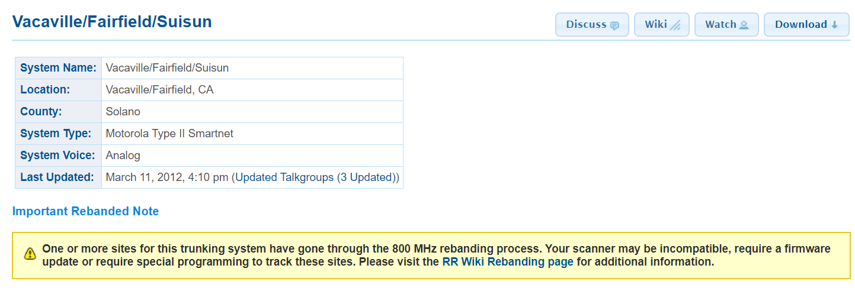
Radio Reference
The system here only has four control channels so it isn’t too difficult to find the right one.

Slide 9
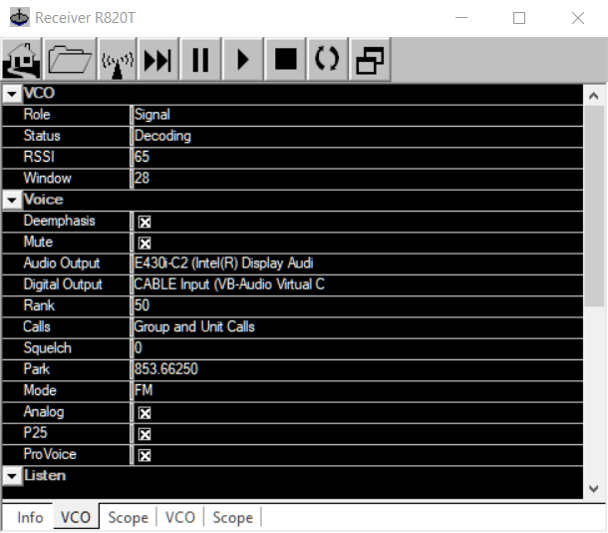
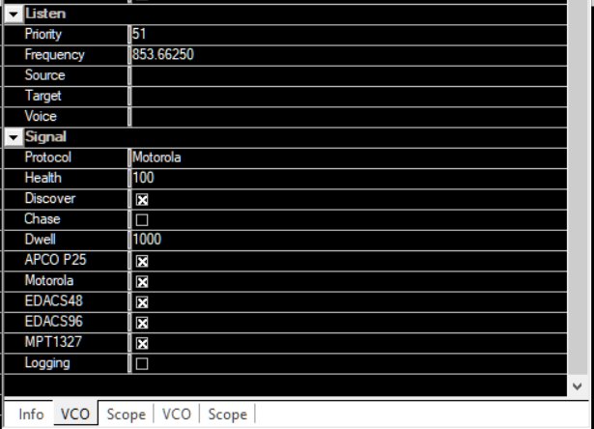
Unitrunker Settings
May or may not work
Control Frequency

Slide 10
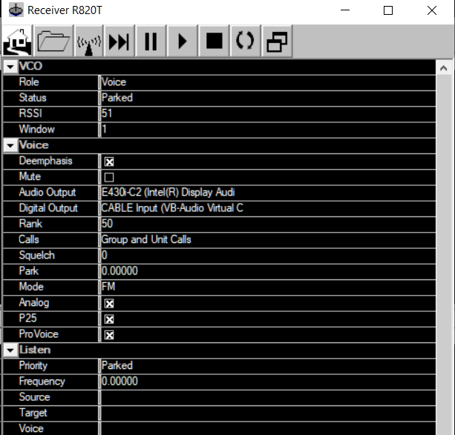
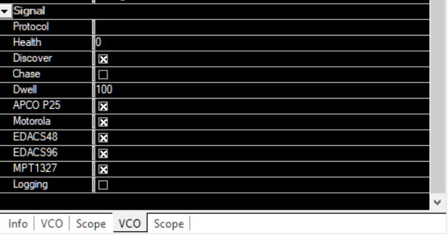
Unitrunker Settings
Un-mute to listen to traffic

Slide 11
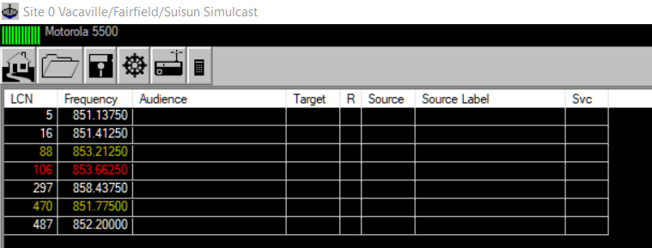
Frequencies in use
Red shows control channel in use.
This channel, at least here, switches between the other Control channels throughout the day.

Slide 12
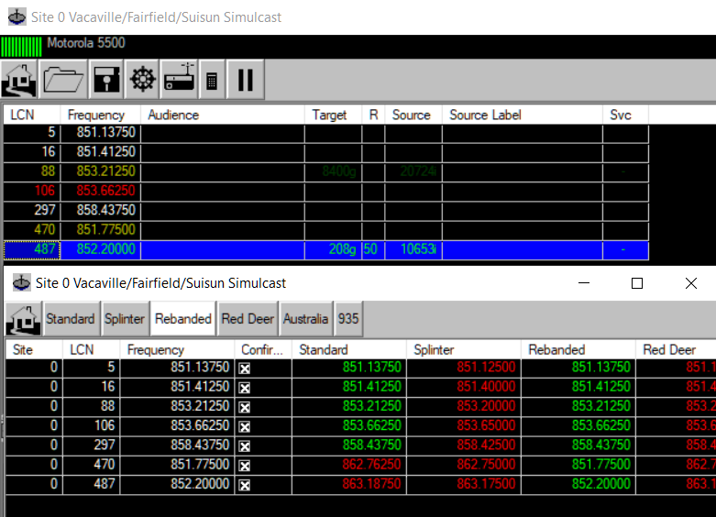
Rebranded
Select the Calculator Icon called Wizard
Click the Rebranded Tab
Close the Wizard window
The system here uses the “Rebranded” configuration.
Read more here:
https://wiki.radioreference.com/index.php/Rebanding

Slide 13
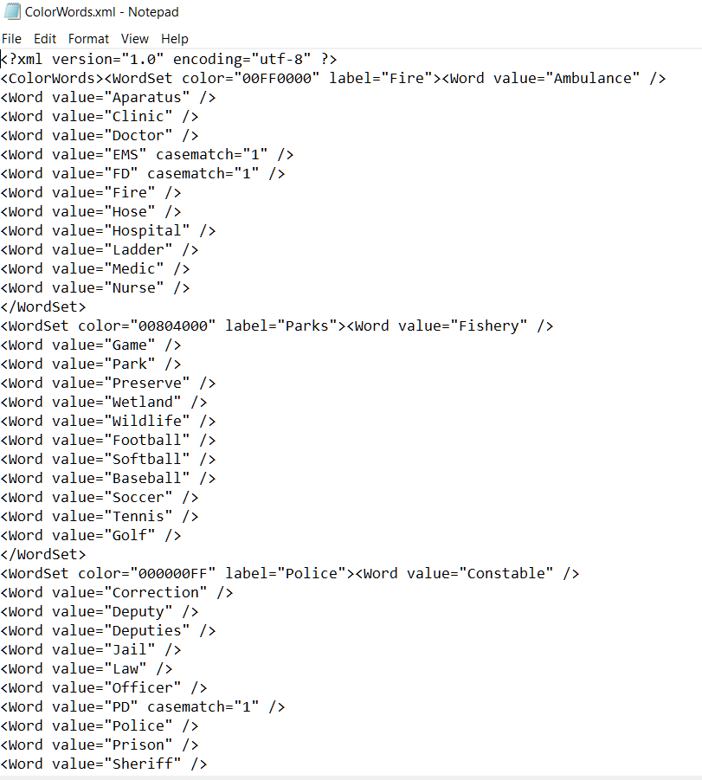
Advanced Configuration
Assign color to transmissions to differentiate between different services such as Law Enforcement, Emergency Medical Services, etc.
Should be automatically applied after download, unfortunately I don’t have an account to test this feature

Slide 14
Unitrunker Demonstration Video

Slide 15
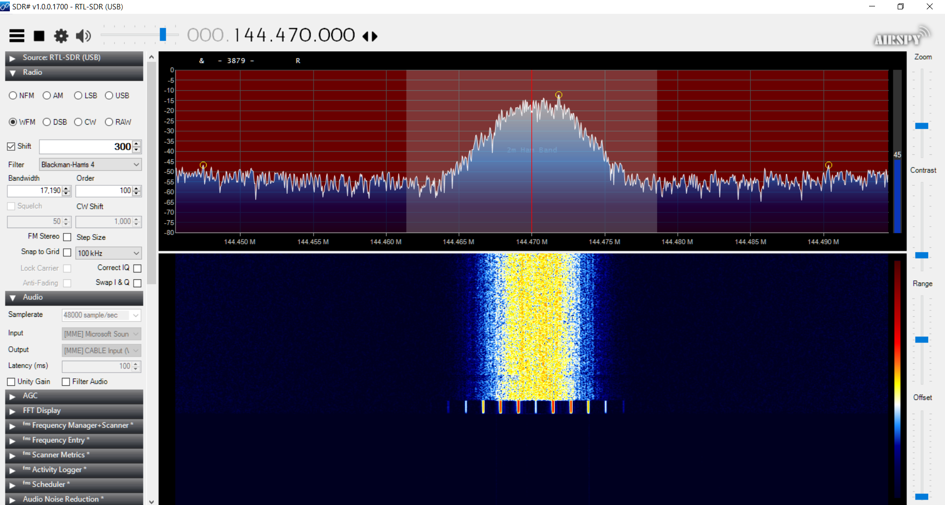
SDR#

Slide 16
SDR#
My goto SDR software
Made by Airspy
Supports multiple formats such as Wideband FM, Narrowband FM, Upper, Lower, and Dual Sidebands, and Carrier Wave.
Has a multitude of features to assist with audio filtering, decoding CTCSS (PL) and DCS codes
Can use as a radio scanner with a frequency manager plugin
Customizable waterfall similar to expensive ICOM, Yaesu, and Kenwood radios.
Plugins for just about every thing you can imagine

Slide 17
SDR# Demonstration Video

Slide 18
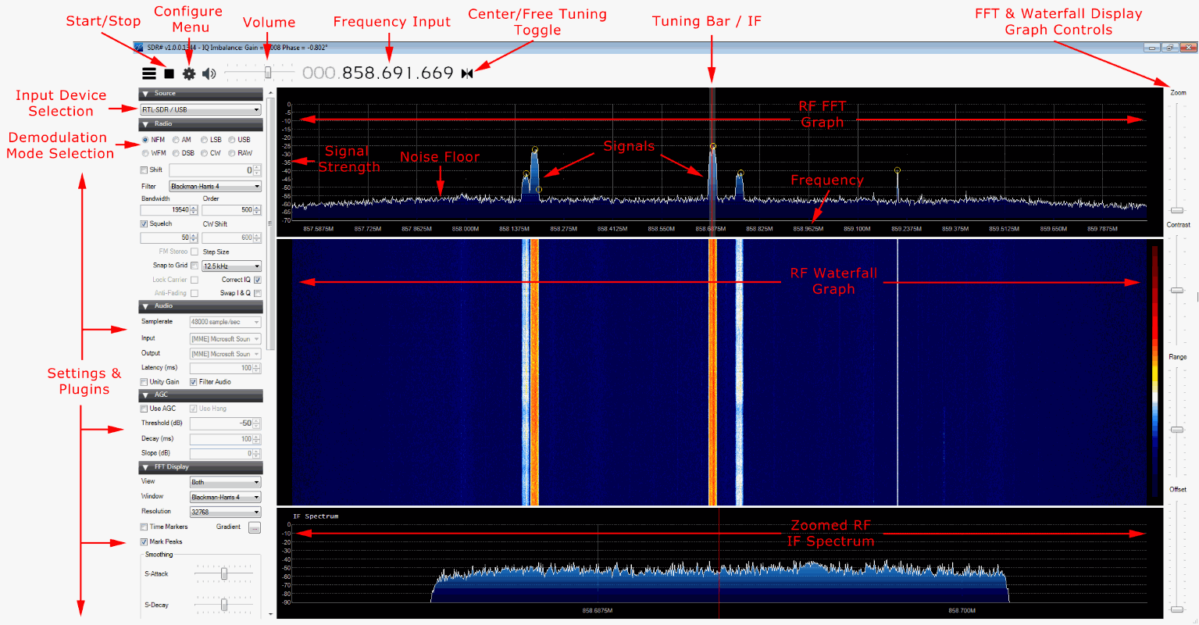
SDR# Quick GUI Overview

Slide 19
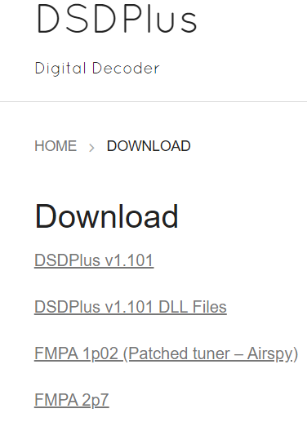
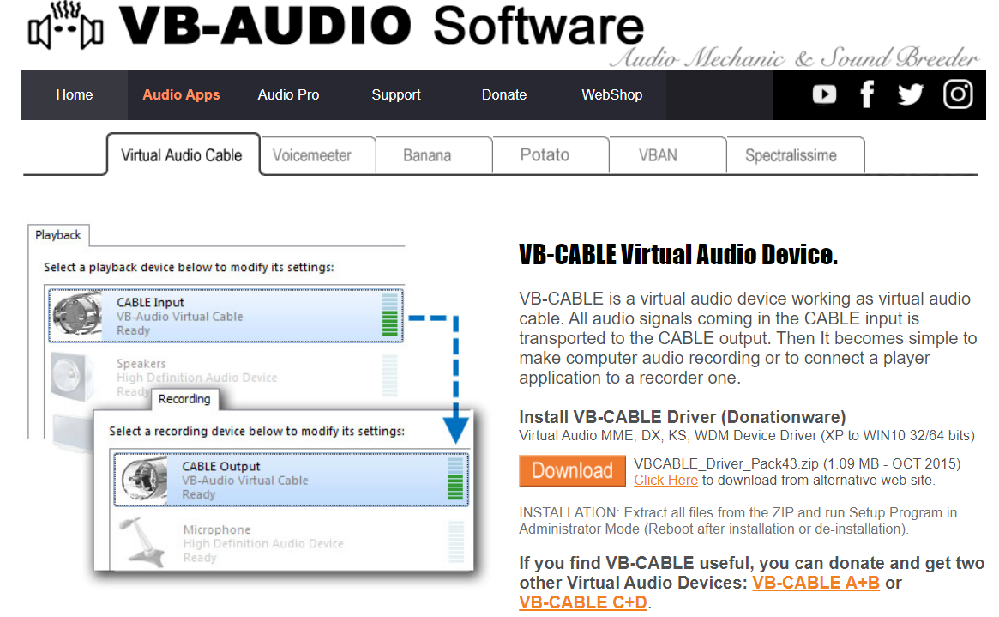
Decoding Digital
Requirements
Audio source from SDR# or any app that can output audio to a device of your choosing
VBCable
DSD Plus

Slide 20
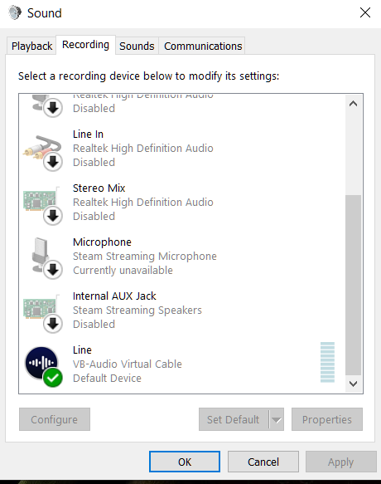
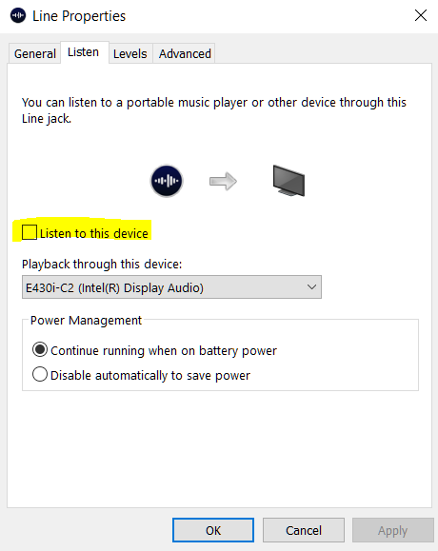
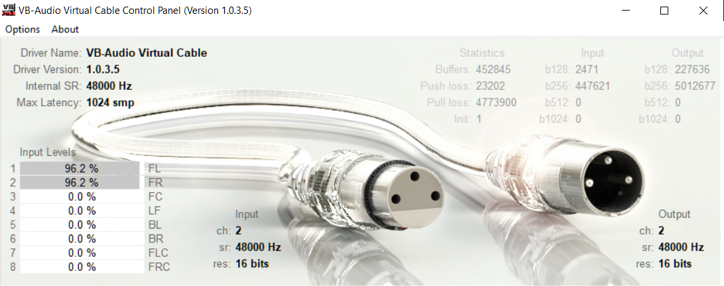
Decoding Digital
Install VBCable
Change sampling Rate in VBCable Control panel to 48000Hz
Restart PC
Change Audio Recording to
VB- Audio Virtual Cable
Uncheck Listen to this
Device

Slide 21
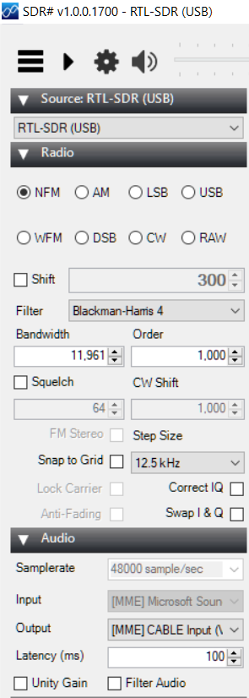
Decoding Digital
Open and Extract both DSD Plus v1.01 and DLL files into the same folder
Run DSDPlus.exe
Run SDR# or equivalent and tune to DMR Frequency
Turn off squelch and all audio filters
Under Audio, select Output as the VB Cable Input

Slide 22
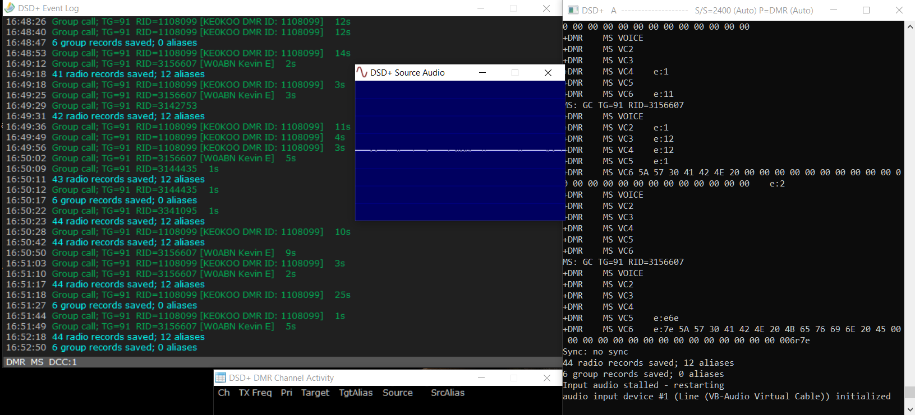
DSD Plus in Action

Slide 23
DSD Decoding Demonstration

Slide 24
Tracking Aircraft with RTL1090
What it does
Shows basic aircraft information
Tail Number
Call sign
Altitude
Speed
Current Location
Bearing
Uses ADS-B data from aircraft
Automatic Dependent Surveillance - Broadcast
Author 90% certain it is:
Günter Köllner DL4MEA

Slide 25
Android SDR App
Online hosted SDR with multiple bands
Servers located worldwide

Slide 26
WebSDR Demonstration

Slide 27
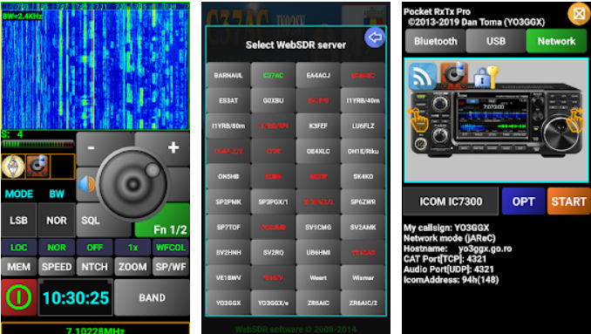
Android Pocket RxTx
WebSDR for your phone
Uses same servers as WebSDR.org
Multiband receiver in your pocket
Needs the Internet
Can control networked transceivers

Slide 28
Android Pocket RxTx Demonstration

Slide 29
What can I do with my $20 SDR stick?
Use as a police radio scanner.
Listening to EMS/Ambulance/Fire communications.
Listening to aircraft traffic control conversations.
Tracking aircraft positions like a radar with ADSB decoding.
Decoding aircraft ACARS short messages.
Scanning trunking radio conversations.
Decoding unencrypted digital voice transmissions such as P25/DMR/D-STAR.
Tracking maritime boat positions like a radar with AIS decoding.
Decoding POCSAG/FLEX pager traffic.
Scanning for cordless phones and baby monitors.
Tracking and receiving meteorological agency launched weather balloon data.
Tracking your own self launched high altitude balloon for payload recovery.
Receiving wireless temperature sensors and wireless power meter sensors.
Listening to VHF amateur radio.
Decoding ham radio APRS packets.
Watching analogue broadcast TV.
Sniffing GSM signals.
Using rtl-sdr on your Android device as a portable radio scanner.
Receiving GPS signals and decoding them.
Using rtl-sdr as a spectrum analyzer.
Receiving NOAA weather satellite images.
Listening to satellites and the ISS.
Radio astronomy.
Monitoring meteor scatter.
Listening to FM radio, and decoding RDS information.
Listening to DAB broadcast radio.
Listening to and decoding HD-Radio (NRSC5).
Use rtl-sdr as a panadapter for your traditional hardware radio.
Decoding taxi mobile data terminal signals.
Use rtl-sdr as a high quality entropy source for random number generation.
Use rtl-sdr as a noise figure indicator.
Reverse engineering unknown protocols.
Triangulating the source of a signal.
Searching for RF noise sources.
Characterizing RF filters and measuring antenna SWR.
Decoding Inmarsat STD-C EGC geosynchronous satellites.
Listening to the ISS (International Space Station).
Not all of these are legal in every country
WOW

Slide 30
Links
DSD Plus https://www.dsdplus.com/download-2/
VBCABLE https://www.vb-audio.com/Cable/
SDR# https://airspy.com/download/
RTL1090 https://rtl1090.com/
WebSDR http://www.websdr.org/

